Slide 1









Slide 2





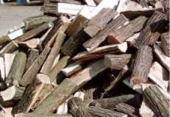
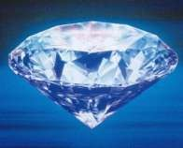
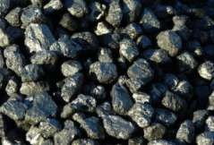
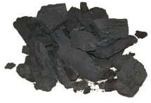
Carbon is found in the atmosphere, inside the earth’s crust and in all living organisms. Carbon is present in fuels likewood, coal, charcoal, coke, petroleum, natural
Carbon is present in compounds like carbonates, hydrogen
Carbon is found in the free state as
diamond, graphite, fullerenes etc.
gas, biogas, marsh gas etc.

Slide 3








The atomic number of carbon is 6, its electronic arrangement is 2,4, it has 4 valence electrons. It can attain stability by gaining 4 electrons, losing 4 electrons or sharing 4 electrons with other atoms. It does not gain 4 electrons because it is difficult for the 6 protons to hold 10 electrons. It does not lose 4 electrons because it needs a large amount of energy to lose 4 electrons. So it shares 4 electrons with other atoms to attain stability resulting in the formation of covalent bonds. Since carbon atom needs 4 electrons to attain stability, its valency is 4 and it is
C
X
tetravalent.
I
_ _{C} _
I
X
X
X

Slide 4








bond, sharing of two pairs of electrons results in the formation of double covalent bond and sharing of three pairs of electrons results in the formation of triple covalent bond.
Covalent bond is chemical bond formed by the sharing of electrons between atoms. The sharing of one pair of electrons results in the formation of single covalent
Eg :- Formation of single covalent bond in Hydrogen molecule - H₂
The atomic number of hydrogen is 1, its electronic arrangement is 1, it has 1 valence electron. It needs 1 electron more to attain stability. So two hydrogen atoms share 1 pair of electrons resulting in the formation of a single covalent bond in hydrogen molecule H_{2.}
H * * H
*
*
H H H₂
H
H

Slide 5











The atomic number of oxygen is 8, its EC is 2,6, it has 6 VE, it needs 2 electrons more to attain stability. So two oxygen atoms share two pairs of electrons resulting in the formation of a double covalent bond in oxygen molecule O₂
X X
O
X X
X X
O
X X
X X
O
X X
X X
O
X X
X X
X X
O=O
O₂
X X
X X
The atomic number of nitrogen is 7, its EC is 2,5, it has 5 VE, it needs 3 electrons more to attain stability. So two
nitrogen atoms share three pairs of electrons resulting in the
formation of a triple covalent bond in nitrogen molecule N₂
X
N
X
X
X
N
X
X
N
X
X X X
X X X
N
X X X X X X
N N N₂
X

Slide 6
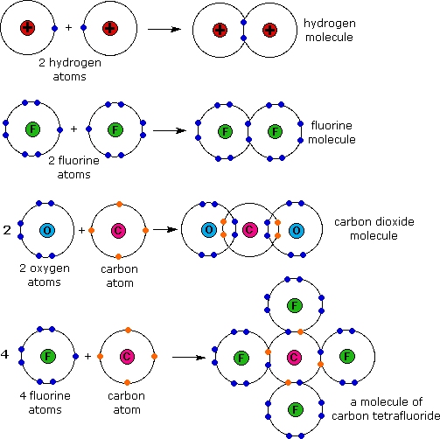

Slide 7






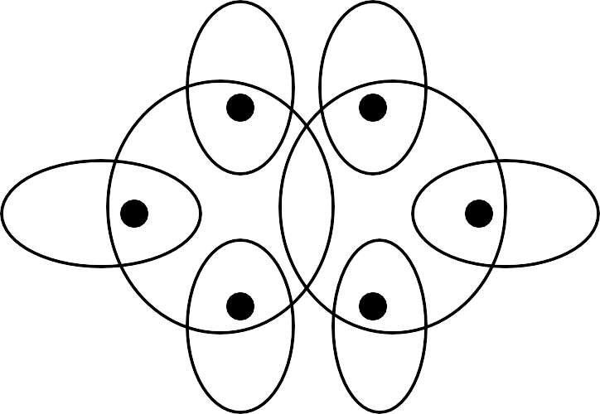


Methane molecule – CH₄
H
X
Ethane molecule – C₂H₆
H
X
H
X
C
X
C
X
H
X
X
H
H
X
X X
X
H
X
H
H
H
H |  | H | H
I H – C – H | H | I – C | I – C – H
I |  | I | I
H |  | H | H

Slide 8






Carbon forms a very large number of compounds. The number of carbon compounds is more than three million. It is more than the number of compounds formed by all other elements. This is because :-
Carbon atom can form bonds with other carbon atoms to form long chains, branched chains and closed rings. This property is called catenation.
Since the valency of carbon is 4, it can form bonds with other carbon atoms or with atoms of other elements like hydrogen oxygen, nitrogen, halogens etc_. _{C _}
I I I I C
_
_
_
_
C C
C C
I I I I I I
C – C – C – C
C – C – C – C – C – C I I I I I I
I I I I
_ _{C} _
I
C
Long chain
Branched chain
Closed ring

Slide 9



Hydrocarbons :- are compounds containing carbon and hydrogen atoms.
Saturated hydrocarbons :- are hydrocarbons having all single covalent bonds between the carbon atoms.
Eg : Alkanes :- have all single covalent bonds between the carbon atoms and their names end with – ane.
H I
Methane – CH4 H – C – H
I
H
H
I
Ethane – C2H6
H – C – C – H
I I
H H

Slide 10
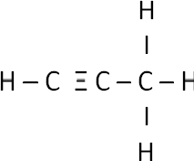
iii) Unsaturated hydrocarbons :- are hydrocarbons having a double or triple covalent bond between two carbon atoms. Eg : Alkenes and Alkynes.
Alkenes :- have a double covalent bond between two carbon atoms. and their names end with – ene.
H H I I |  | H I | H I | H
C = C Propene – C3H6 H – C – C – C
I | I | I | H
H | H | H
e covalent bond between two carbon atoms and
Ethene - C2H4
Alkynes :- have a tripl
their names end with – yne.
Ethyne – C2H2 H – C Ξ C – H
Propyne - C3H4

Slide 11


Carbon compounds having the same molecular formula but different structural formulae are called isomers. This property is called isomerism. Eg:- Butane – C₄H₁₀ has 2 isomers. They are Normal butane and Iso butane.
H H | H | H | H | H | H
I I | I | I | I | I | I
H – C – C – C – C – H
H – C – C – C – H
Iso butane
I | I | I | I | I | I
H | H | H | H | H | H
H – C – H I
H
Normal butane
Pentane – C₅H₁₂ has 3 isomers. They are Normal pentane, Iso pentane and Neo
pentane. |  |  |  |  | Iso pentane |  |  | Neo pentane H
 |  |  |  |  | H |  |  | I
Normal pentane |  |  |  |  | I H – C – H |  |  | H – C – H H H I I
H H |  | H H |  | H | H | H |  | H | H – C – | C – | C – H
I I |  | I I |  | I | I | I |  | I | I |  | I
H – C – C – C – C – C – H H – C – C – C – C – H H H
I | I I |  | I | I | I | I | I | I | H – C – H
H | H H |  | H | H | H H |  | H | H | I H

Slide 12

An atom or a group of atoms which decides the properties of a
carbon compound is called a functional group.
Halide ( Halo group) :- - Cl, - Br, etc. ( Names end with – ane )
Eg :- CH₃Cl – Chloro methane, C₂H₅Br – Bromo ethane
Alcohol :- - OH ( Names end with – ol )
Eg :- CH₃OH – Methanol,
C₂H₅OH – Ethanol
H
( Names end with – al )
O
iii) Aldehyde :- - CHO - C
Eg :- HCHO – Methanal,
CH₃CHO – Ethanal
iv) Carboxylic acid :- - COOH - C - OH (Names end with – oic acid ) Eg :- HCOOH – Methanoic acid, CH₃COOH – Ethanoic acid
v) Ketone :- - CO
- C - (Names end with – one )
II O
Eg :- CH₃COCH₃ – Propanone ,
CH₃COC₂H₅ - Butanone

Slide 13
Homologues series
Homologus series is a group of carbon compounds having similar structures, similar chemical properties and whose successive members differ by a – CH₂ group. Eg :- Alkanes, Alkenes, Alkynes etc.
Alkanes :- have general molecular formula C_{n}H_{2n+2} . Their names end
with – ane and the members are as follows :-
Methane Ethane Propane Butane Pentane
CH₄
C₂H₆
C₃H₈
- C₄H₁₀
- C₅H₁₂
H I
Methane :– CH₄ H – C – H
I H
H
I
H H
I I
Ethane :– C₂H₆
H – C – C – H
Propane – C₃H₈
H – C – C – C – H
I | I | I | I | I
H | H | H | H | H

Slide 14


Alkenes have general molecular formula C_{n}H_{2n} . Their names end with – ene and the members are as follows :-
Ethene - C₂H₄ Propene - C₃H₆ Butene - C₄H₈ Pentene - C₅H₁₀
H
I
Ethene :-
C₂H₄
C = C
I I
H H
H H
I I
H H H
I I I
Propene :- C₃H₆
H – C = C – C – H Butene :- C₄H₈
I H
H – C = C – C – C – H
I I
H H

Slide 15


Alkynes have general molecular formula C_{n}H _{2n – 2} .Their names end with – yne and the members are as follows :-
Ethyne :- C₂H₂ H – C C – H
H I
C – C – H I
H
Propyne :- C₃H₄ H – C
H H
I I
Butyne :- C₄H₆
H – C C – C – C – H
I I
H H

Slide 16








a) Combustion :-
Carbon compounds burn in oxygen to form water, carbon dioxide, heat and light.
Eg :- C + O₂
CH₄ + 2O₂ C₂H₅OH + 3O₂
CO₂ + heat + light
2H₂O + CO₂ + heat + light 3H₂O + 2CO₂ heat + light
b) Oxidation :-
Carbon compounds like alcohols are oxidised to carboxylic acids on heating with oxidising agents like alkaline Potassium permanganate
– KMnO₄ or acidic potassium dichromate - K₂Cr₂O₇ .
Eg:- Alcohols are oxidised to Carboxylic acids
alkaline KMnO₄ + heat
C₂H₅OH
Ethanol acidic K₂Cr₂O₇ + heat
CH₃COOH
Ethanoic acid

Slide 17
c) Addition reaction :-
Unsaturated hydrocarbons undergo addition reaction with hydrogen in the
presence of nickel or palladium as catalyst to form saturated hydrocarbons.
Eg:- Ethene undergoes addition reaction with hydrogen to form ethane in the presence of nickel or palladium as catalyst.
Ni or Pd catalyst
C₂H₄ + H₂ C₂H₆
H
I Ni or Pd catalyst
H H
I I
C = C + H₂
H – C – C – H
I I
H H
I I
H H
The addition of hydrogen to unsaturated hydrocarbons to form saturated hydrocarbons is called hydrogenation. Hydrogenation is used to convert unsaturated oils and fats to saturated oils and fats.
d) Substitution reaction :-
Saturated hydrocarbons undergo substitution reaction with halogens to form substitution products.
Eg :- Methane undergoes substitution reaction with chlorine in the presence
of sunlight to form substitution products.
CH₄ + Cl₂ CH₂Cl₂ + Cl₂
CH₃Cl + HCl CHCI₃ + HCl
CH₃Cl + Cl₂ CHCI₃ + Cl₂
CH₂Cl₂ + HCl CCl₄ + HCl

Slide 18
11) Some important carbon compounds :-
ETHANOL :- C₂H₅OH - Ethyl alcohol
Properties :-
  Ethanol is a colourless liquid with a pleasant smell and burning taste.
  It is soluble in water.
  Ethanol reacts with sodium to form sodium ethoxide and hydrogen. 2C₂H₅OH + 2Na 2C₂H₅ONa + H₂
  Ethanol reacts with hot conc. H₂SO₄ to form ethene and water. Conc. H₂SO₄ is a dehydrating agent and removes water from ethanol.
conc. H₂SO₄
C₂H₅OH C₂H₄ + H₂O
Uses :-
    Ethanol is used for making alcoholic drinks.
    It is used as a solvent.
    It is used for making medicines like tincture iodine, cough syrups, tonics etc.

Slide 19
b) ETHANOIC ACID :-
CH₃COOH – Acetic acid
Properties :-
Ethanoic acid is a colourless liquid with a pungent smell and sour taste.
It is soluble in water.
A solution of 5% to 8% ethanoic acid in water is called Vinegar.
Esterification :-
Ethanoic acid reacts with ethanol to form the ester ethyl ethanoate in the presence of conc. H₂SO₄.
conc.H₂SO₄
CH₃COOH + C₂H₅OH CH₃COOC₂H₅ + H₂O
The reaction between carboxylic acid and alcohol to form an ester is called esterification.
Saponification :-
When an ester reacts with sodium hydroxide solution, the sodium salt of the carboxylic acid and the parent alcohol are formed. This reaction is called saponification.
Eg :-Ethyl ethanoate reacts with sodium hydroxide to form sodium acetate and ethanol.
CH₃COOC₂H₅ + NaOH CH₃COONa + C₂H₅OH
Ethanoic acid reacts with bases to form salt and water.
CH₃COOH + NaOH CH₃COONa + H₂O
Ethanoic acid reacts with carbonates and hydrogen carbonates to form salt, water
and carbon dioxide.
2CH₃COOH + Na₂CO₃ CH₃COOH + NaHCO₃
2CH₃COONa + H₂O + CO₂ CH₃COONa + H₂O + CO₂

Slide 20






Soaps :- Soaps are long chain sodium or potassium salts of carboxylic
acids. Eg:- Sodium stearate – C₁₇H₃₅COONa
Structure of soap molecule :- A soap molecule has two parts. A long hydrocarbon part which is hydrophobic (water repelling) and soluble in oil and grease and a short ionic part which is hydrophyllic (water attracting) and insoluble in oil and grease.
COO Na ⁺
Hydrocarbon part
(Water repelling)
Ionic part
(Water attracting)
Cleansing action of soap :-
When soap is dissolved in water it forms
spherical structures called micelles. In each micelle the soap molecules are arranged radially such that the HC part is towards the centre and the ionic part is towards the outside. The HC part dissolves the dirt, oil and grease and forms an emulsion at the centre of the micelles which can be washed away by water.

Slide 21
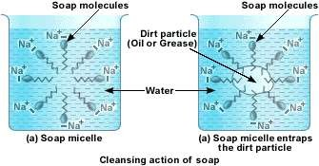

Slide 22
b) Detergents :-
Detergents are long chain sodium salts of sulphonic acids.
Soaps do not wash well with hard water because it forms insoluble
precipitates of calcium and magnesium salts in hard water.
Detergents wash well with hard water because it does not form insoluble precipitates of calcium and magnesium salts in hard water.
Soaps | Detergents
Soaps are sodium salts of fatty acids. | Detergents are sodium salts of sulphonic acids.
Soaps clean well in soft water but do not clean well in hard water. | Detergents clean well with both hard and soft water.
Soaps do not clean as well as detergents. | Detergents clean better than soaps.
Soaps are biodegradable and do not cause pollution. | Some detergents are non biodegradable and cause pollution.

